Slide 1
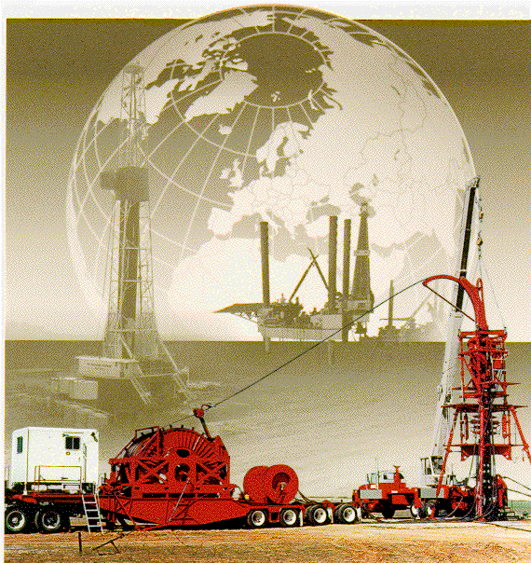
Coiled Tubing Damage
GWDC well Testing Company
Lecturer：Li Xuening

Slide 2
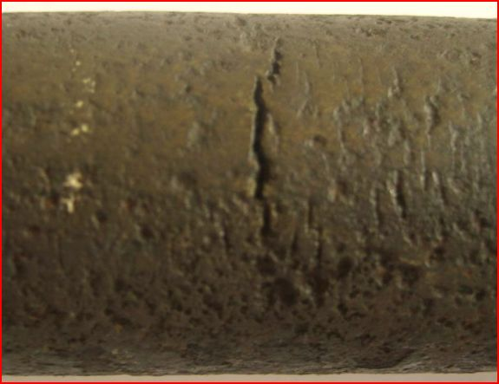
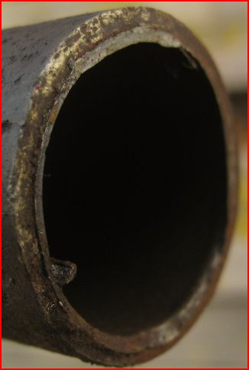
Coiled Tubing Fatigue

Slide 3
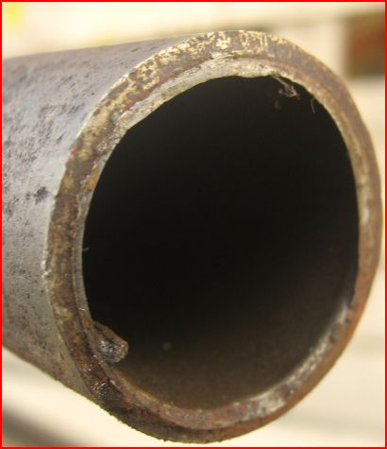
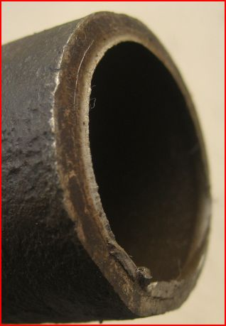
Coiled Tubing Fatigue

Slide 4
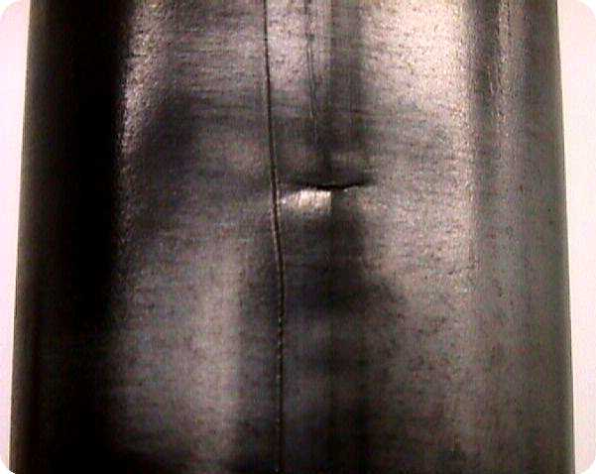
Fatigue Crack
Notes:
Longitudinal are not that detrimental, However transverse can be a problem

Slide 5
Factors Affecting Fatigue Life
OPERATIONAL FACTORS
Tubing Stresses
  Internal pressure applied to tubing while cycling
  Cycles across the gooseneck (guide arch) and reel
  Over pulls (stuck tubing)
Mechanical Damage
  Stress-riser conditions
Equipment & Job Layout
  Bending radii
Corrosive and Abrasive Fluids
  Reduction in wall thickness (strength)
  Stress-riser conditions
Notes:
Simulators only take into account cycles, not axial loads. That is in process.

Slide 6
Factors Affecting Fatigue Life
Parameter Better
Diameter Smaller
Wall Thickness Thicker
Grade (strength) Higher
Section welds Strip bias

Slide 7
Factors Affecting Fatigue Life
DERATING FACTORS FOR WELDS
Bias Weld, Gauge to Gauge 15%
Step Tapered Bias (Different Gauge) 35%
Tube to Tube Gauge to Gauge (Butt-Weld) 50%
Step Tapered Tube to Tube Weld 65%
Notes:
Default ratings from Cerebrus. More qualitative than quantitative

Slide 8
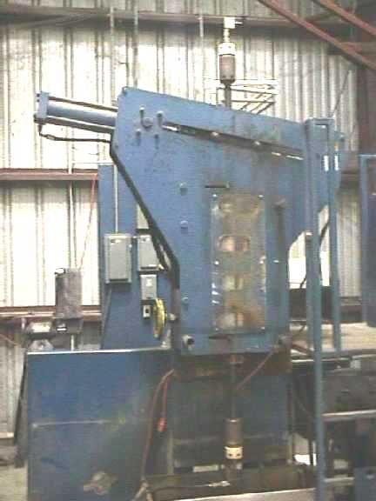
Factors Affecting Fatigue
Internal pressure applied to tubing while cycling
Cycles across stationary guide block (48” or 72” radius)
Internal Pressure and Cycle count registered by Data System

Slide 9
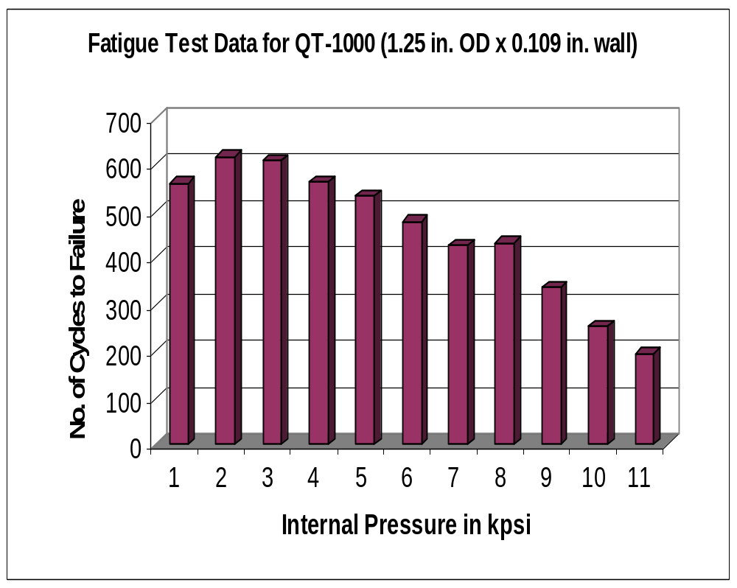
Actual Fatigue Test Results
Average of 5 tests.
Pressures to 15 kpsi
Comparison to theory
Available to industry

Slide 10
COILED TUBING CORROSION ISSUES
Mr. Don VanArnam

Slide 11
Coiled Tubing
HO-70 is a micro alloyed steel
  Low alloy steel with V or Nb to refine grain size
QT-700, QT-800 & QT-900 are high strength low alloy steels
Low alloy steels corrode
  Corrosion rates similar to API tubing (L80)

Slide 12
Uniform Corrosion Rates
1 ¾” O. D. By 0.156” coiled tubing
Corroding at 50 mils per year
Will fail in about 3 years
2 3/8” 5.80 lb/ft T&C L80 has 0.254” wall
Corroding at 50 mils per year
Will fail in about 5 years

Slide 13
Localized Corrosion Factors
Coiled Tubing
  Accelerated by plastic deformation (cycling)
  Often hanging in well environment
  May create crevices at tubing contacts
API Tubulars
  Accelerated at connections
  Hanging in inhibited packer fluid

Slide 14
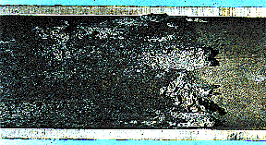
CO₂ Corrosion
H₂O + CO₂ → H₂CO₃ (Carbonic Acid)
H₂CO₃ + Fe → FeCO₃ + H₂

Slide 15
Characteristics of CO2 Corrosion
Round Bottom Pits
Randomly Distributed on Metal Surface
Therefore, Corrosion Rate Predictions may under predict actual penetration rates.

Slide 16
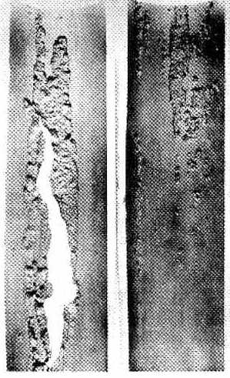
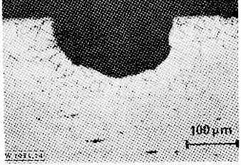
CO₂ Corrosion

Slide 17
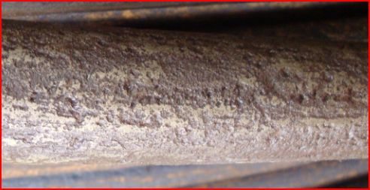
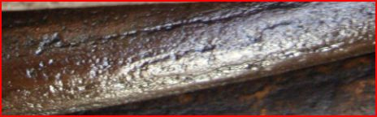
CO₂ Corrosion

Slide 18
Factors Effecting Corrosion Rate
Liquid phase water with CO₂ must contact metal for corrosion to occur.
  Water in vapor phase – no corrosion
  Water saturated in gas – no corrosion
  If metal is oil wetted – no corrosion

Slide 19
Oil Wetting
Inhibiting Film
Water Emulsified in Oil > 50% Oil
Gas
H2O &
CO2
Oil Emulsified in Water < 50% Oil
F
L
O
W
Oil

Slide 20
Factors Effecting Corrosion Rate
Corrosion Rates generally increase with CO₂ partial pressure.
CO₂ is an acid gas and depresses pH when it is dissolved in an aqueous solution. Corrosion rates increase as the pH of the aqueous phase decreases.

Slide 21
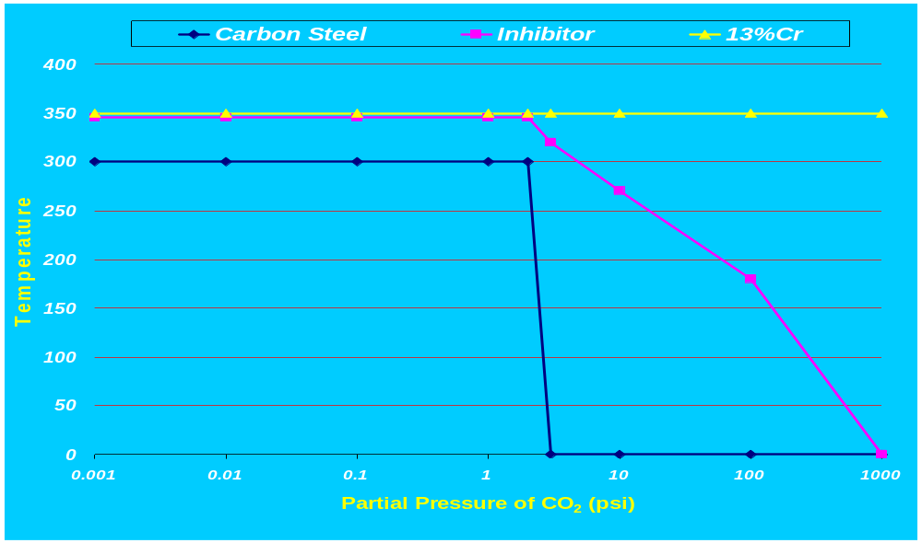
Conceptual Use Limits in CO₂
Actual Limits Dependent on Individual Environments

Slide 22
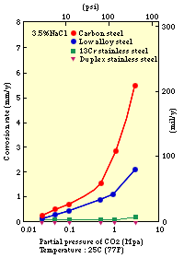
Dependence of Corrosion on CO2 Content and Alloy
Source: Kawasaki Steel

Slide 23
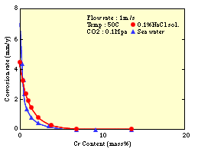
Effect of Cr Content on CO₂ Corrosion
Source: Kawasaki Steel

Slide 24
Effect of Scale on Corrosion
Scale can increase concentration of environment under scale at low flow Rates
Flow
Scale
Hydrogen released in corrosion reaction is trapped in pit and lowers pH

Slide 25

Effect of Scale on Corrosion
High flow velocities remove scale to expose fresh metal to environment
Result often called mesa corrosion

Slide 26
H₂S Corrosion
Sulfide Stress Cracking (SSC)
  Brittle failure by cracking under the combined action of tensile stress and corrosion in the presence of water and hydrogen sulfide.

Slide 27
Sulfide Stress Cracking (SSC)
Occurs in susceptible high strength material
Must be loaded in tension, below yield
Must be in the critical temperature range
Must be exposed to a sour environment
Cracking is trans- granular, branching and perpendicular to stress

Slide 28
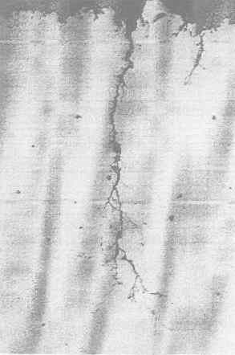
Sulfide Stress Cracking (SSC)

Slide 29
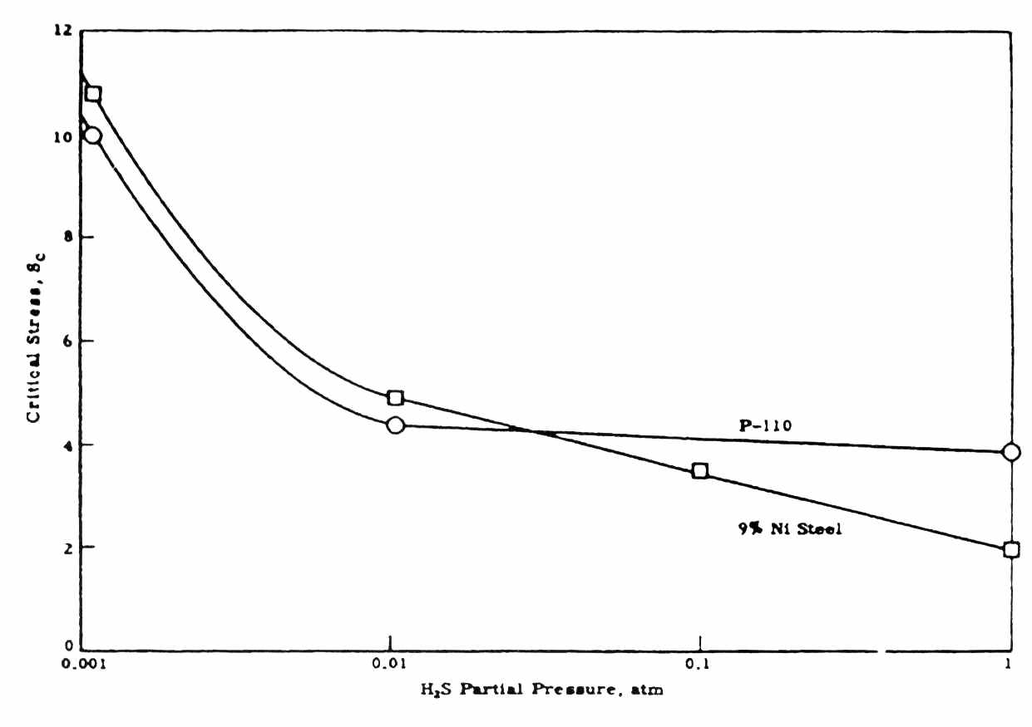
H₂S Partial Pressure Effect

Slide 30
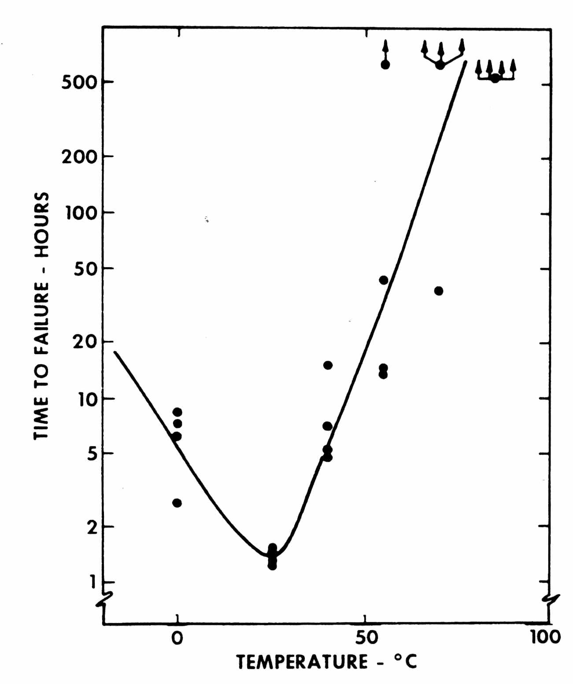
Temperature Effect in H₂S

Slide 31
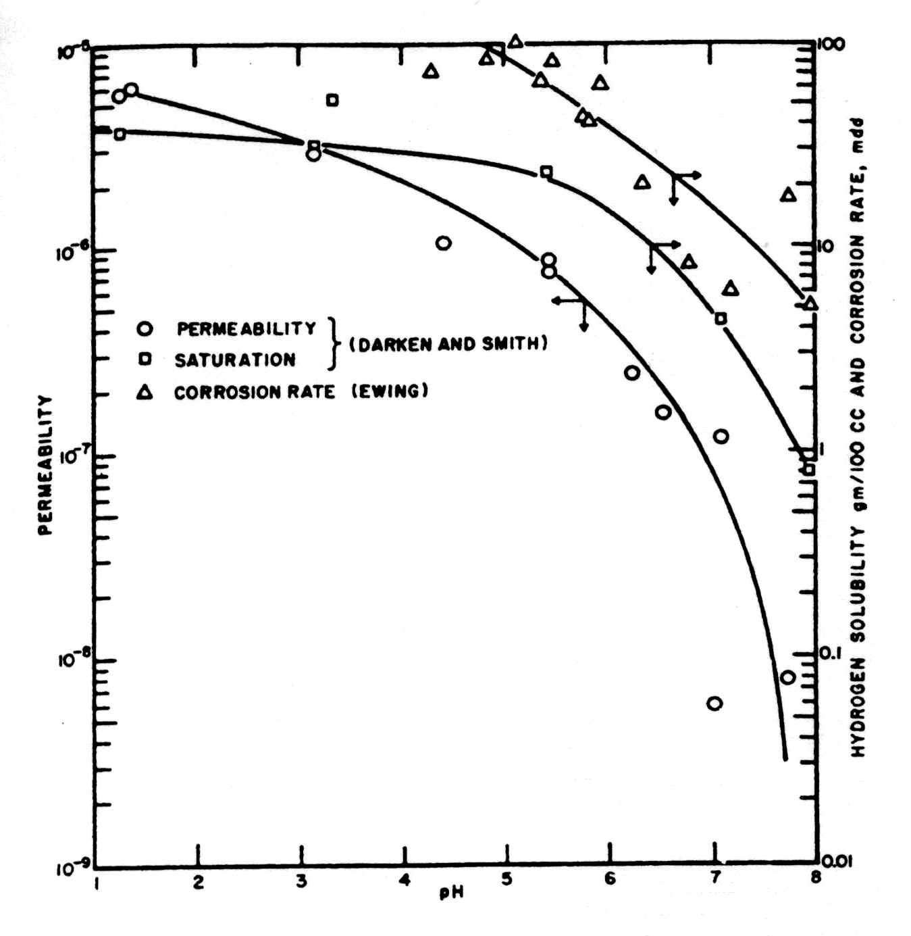
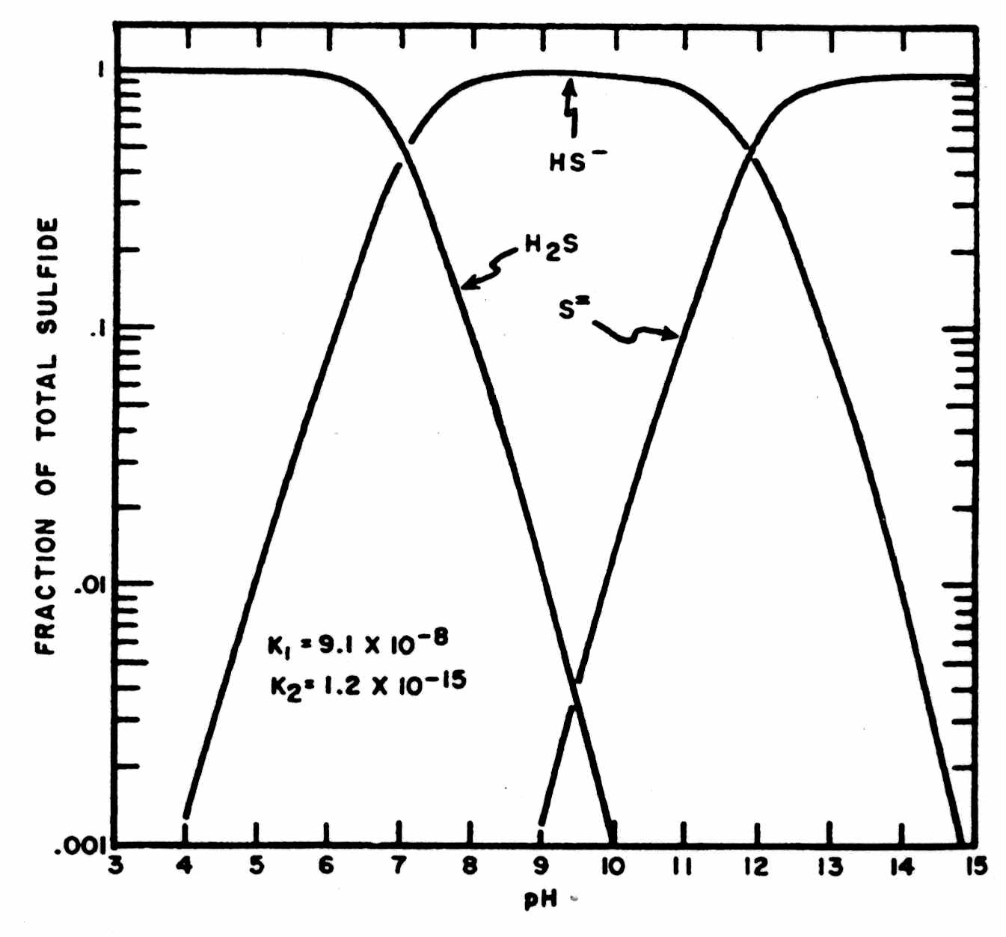
PH Effect on H₂S

Slide 32
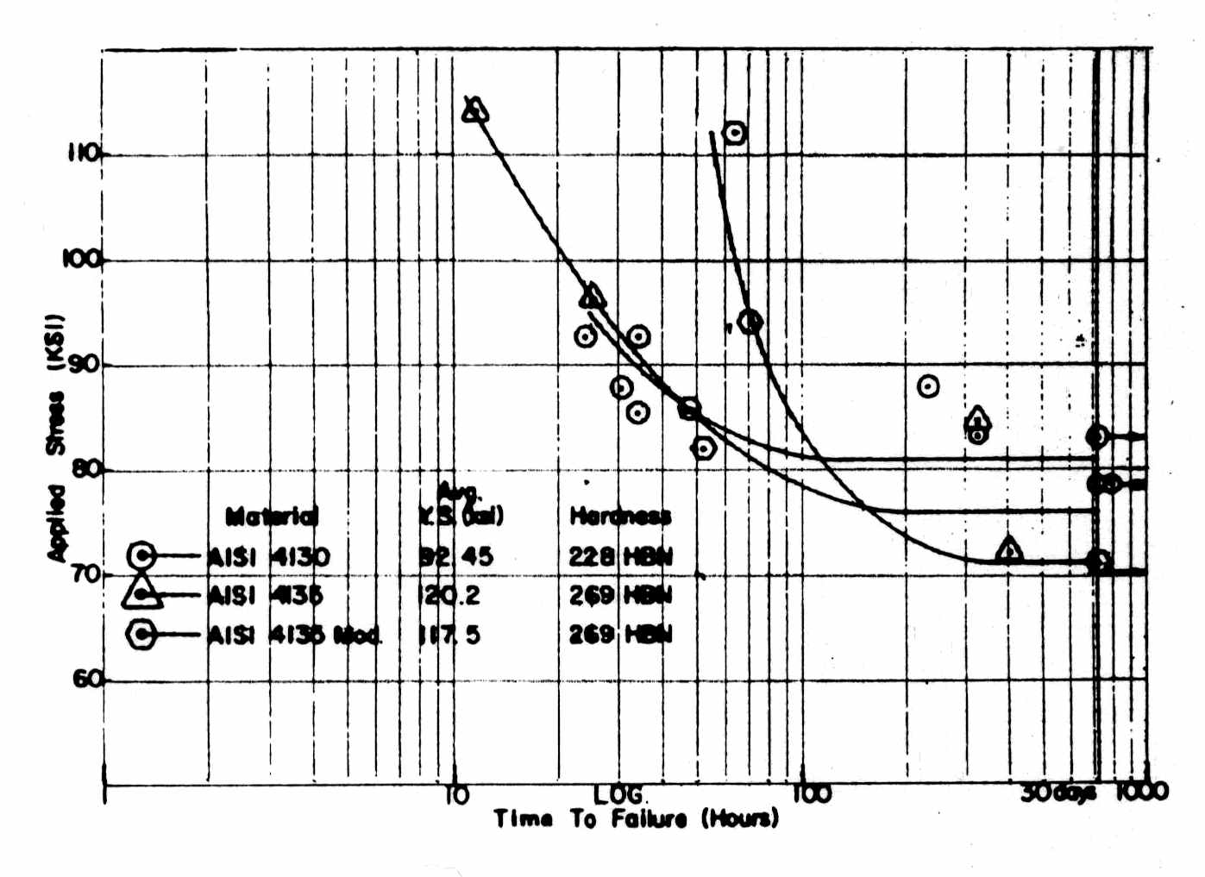
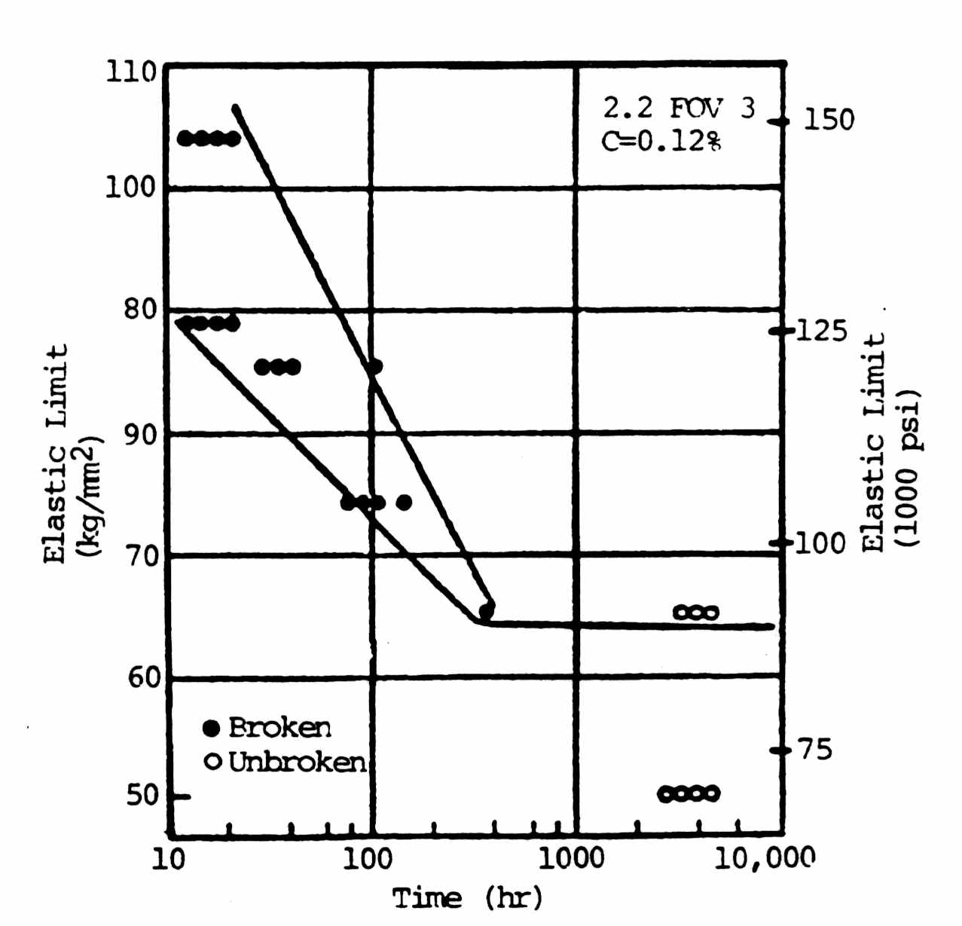
Strength Effect on H₂S

Slide 33
Coiled Tubing In H₂S
Material Type
Process History
Fatigue History
Loading Configuration and Geometry
Service Environment Conditions

Slide 34

Questions???

